Slide 1
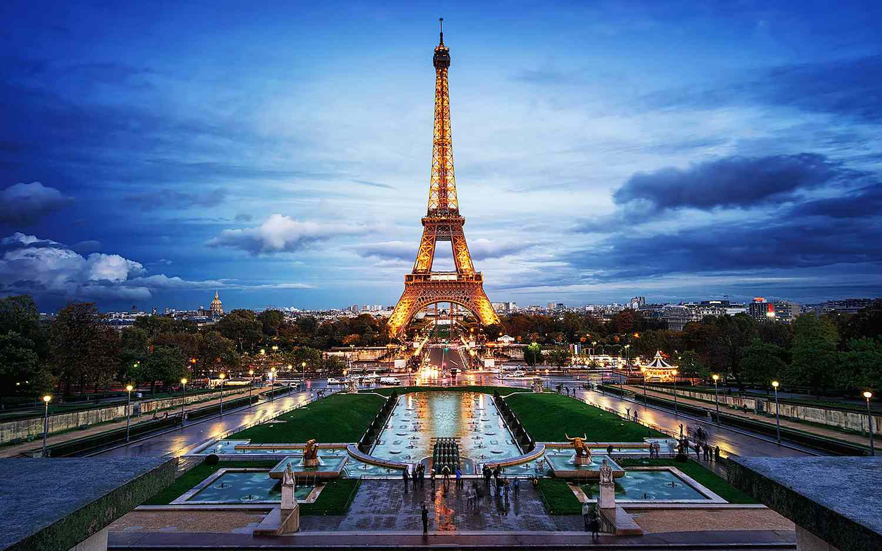

Slide 2
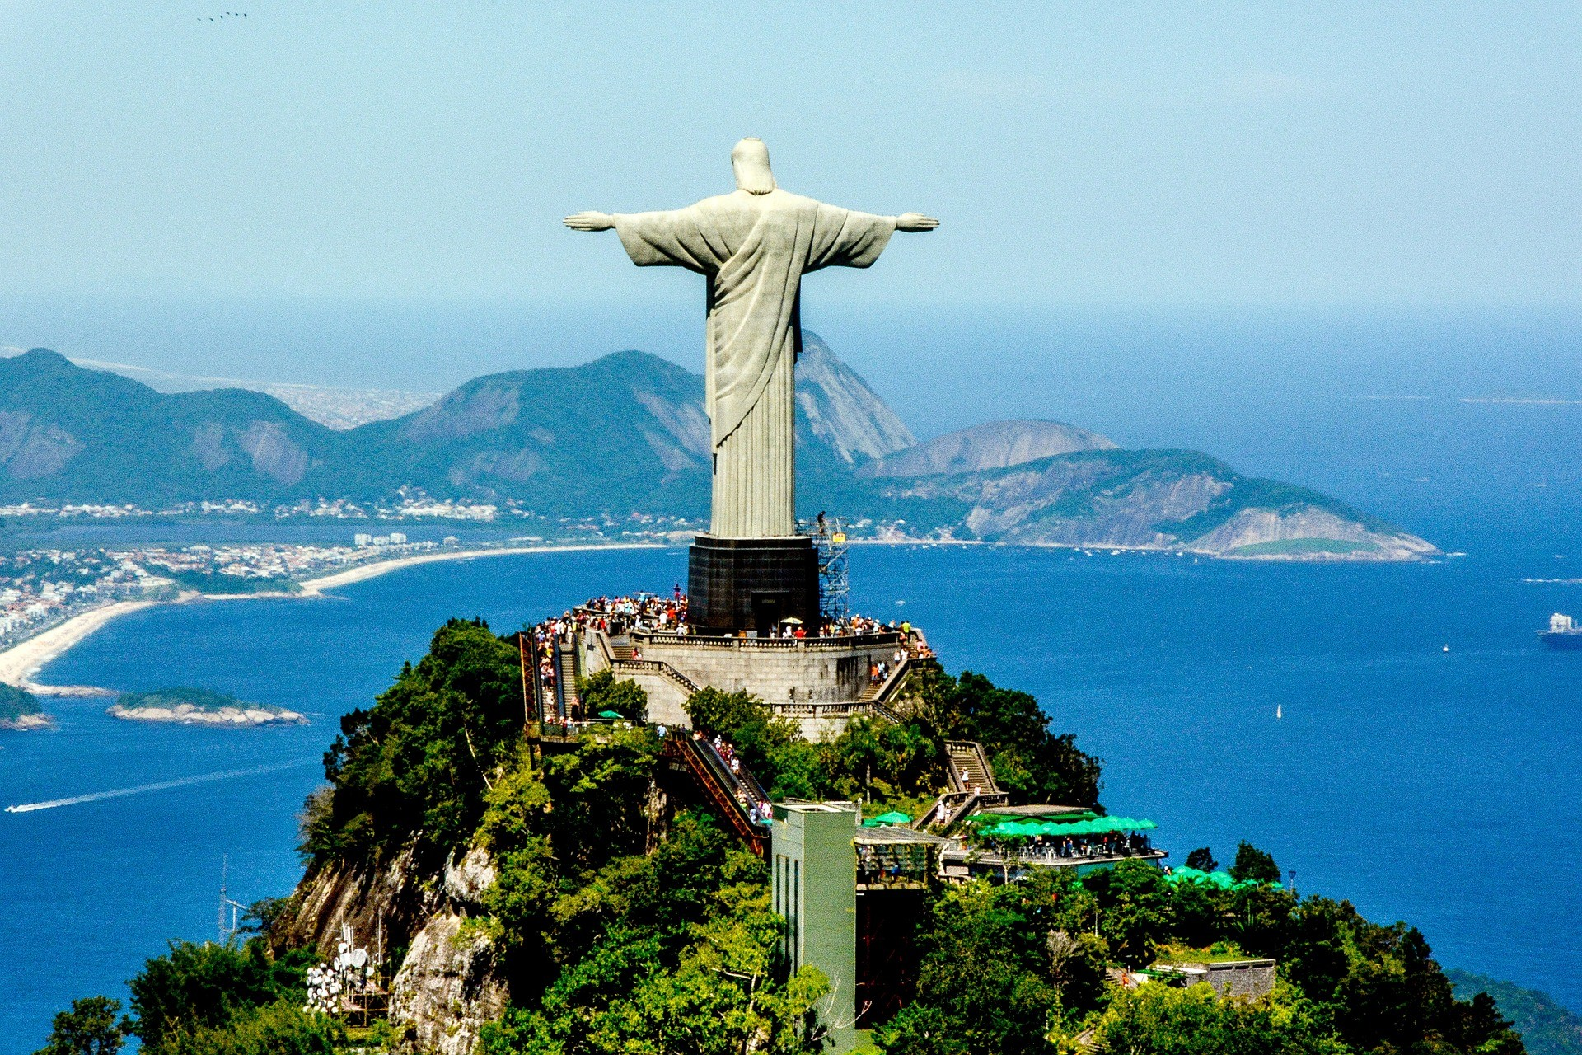

Slide 3
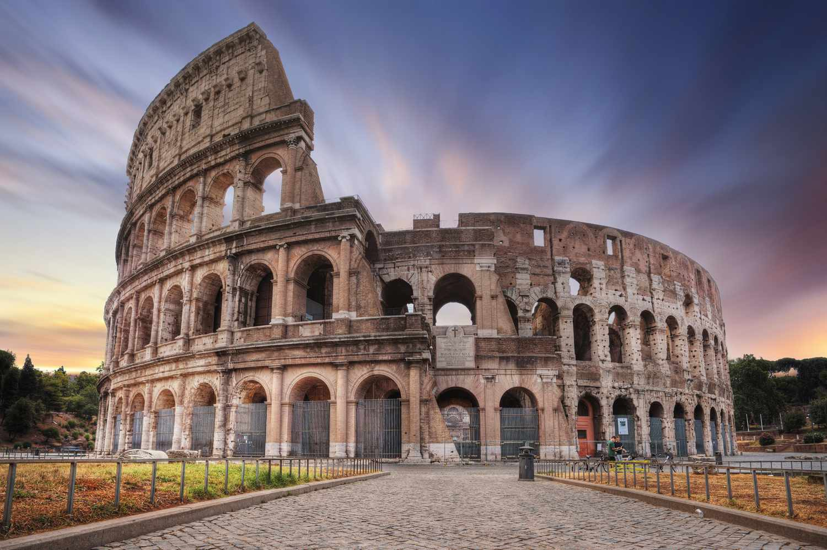

Slide 4
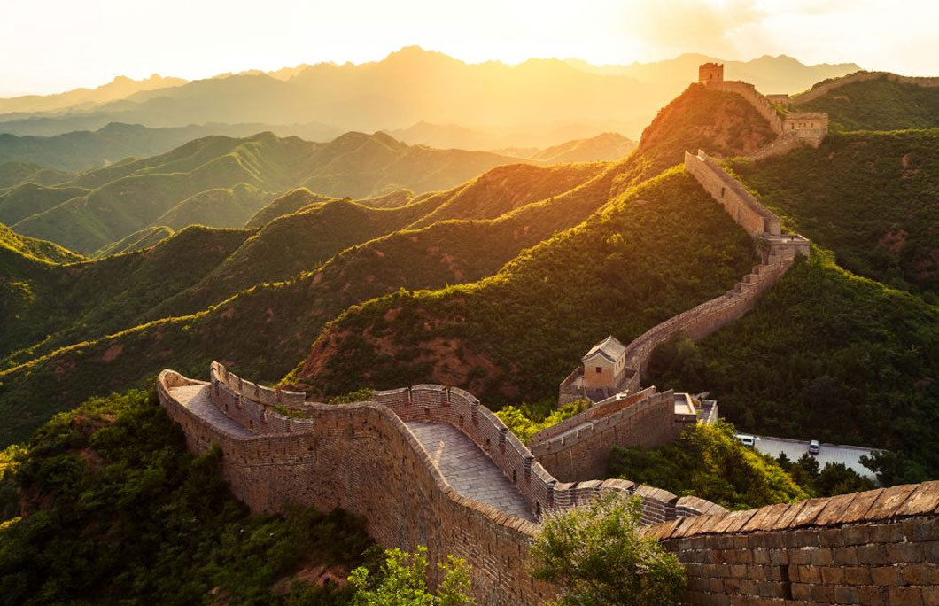

Slide 5
Your Last Holiday
Esal 0450-01/TEsL 3050

Slide 6
Past Tense (Regular)
I walked
You climbed
He fished
She plugged(in)
We sailed
They watched

Slide 7
To Go
To Find
To See
To Swim
To Take
To Wear
To Run
Ran
Found
Wore
Swam
Took
Went
Saw

Slide 8
Additional Conjugations
To Think --- Thought
To Sing --- Sang
To Leave --- Left
To Know --- Knew
To Eat --- Ate
To Drink --- Drank
To Hang --- Hung
To Fly --- Flew
To Write --- Wrote
To Ride --- Rode

Slide 9
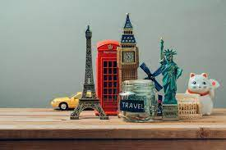
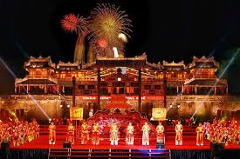
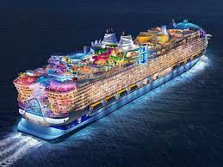
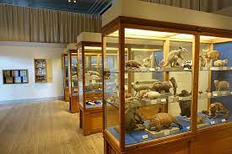
Vocabulary
Souvenir
Monument/Landmark
Beach
Museum
Amusement Park
Hotel/Motel
Cruise
Festival
Notes:
Dam Sen Theme park/ Disney Land

Slide 10





Weather
It is/was
Sunny
Rainy
Cloudy
Stormy

Slide 11
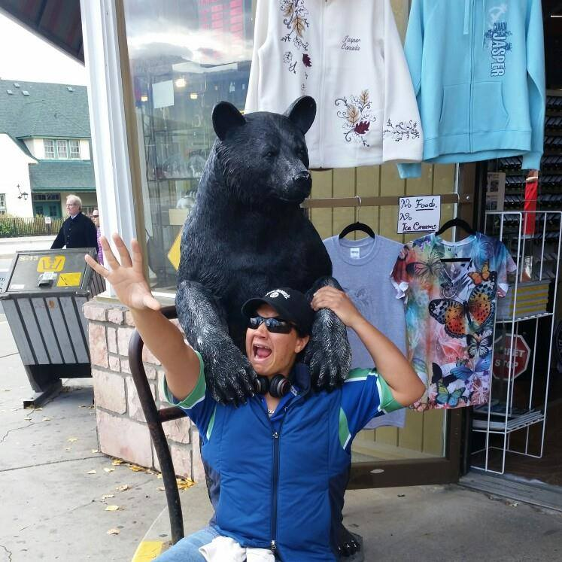
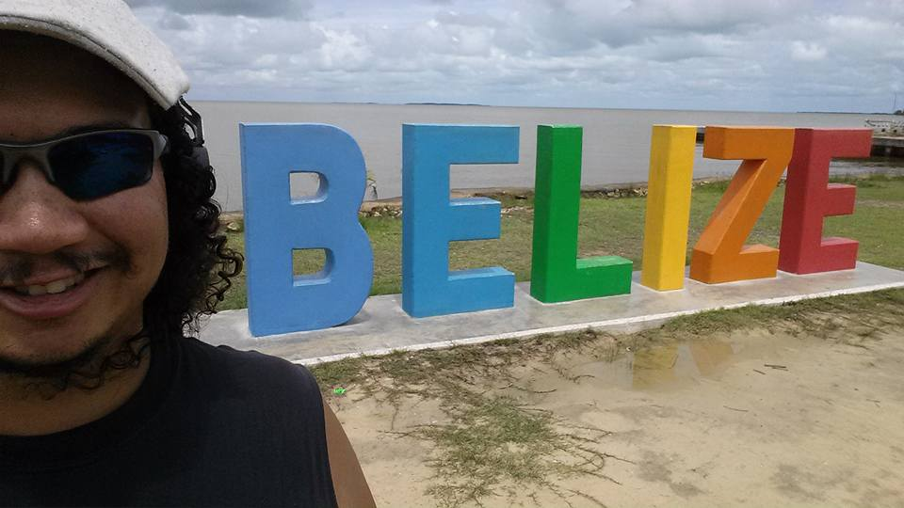
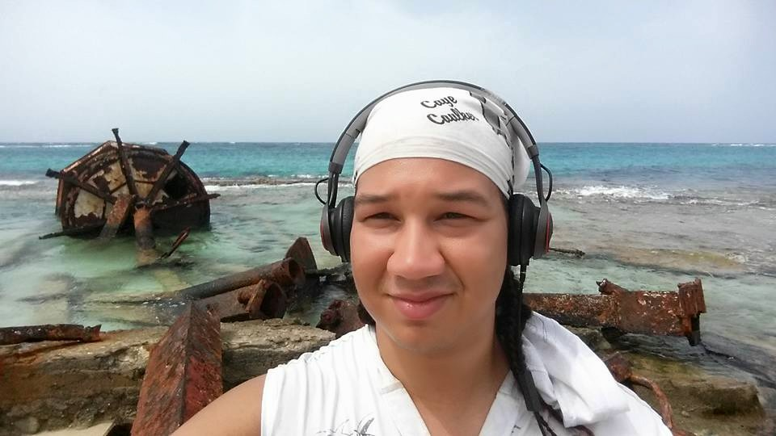
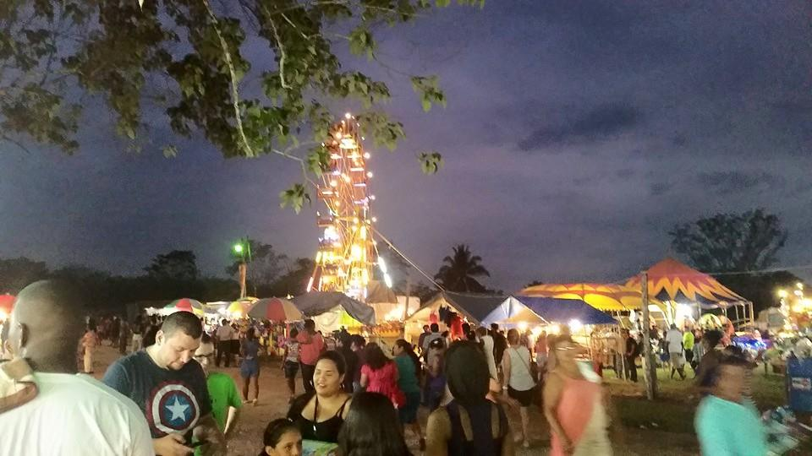
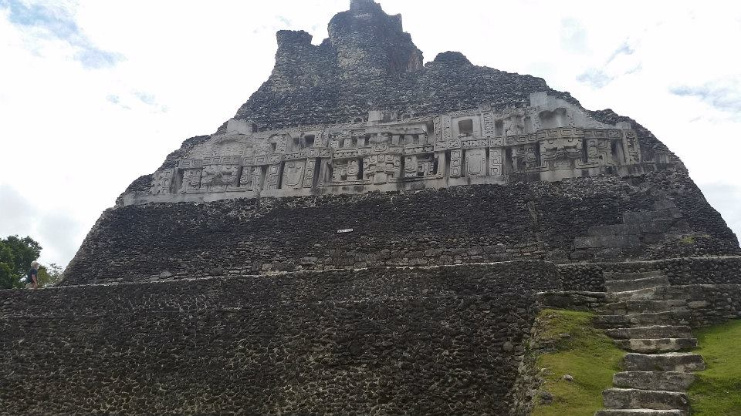
Where did you visit?

Slide 12
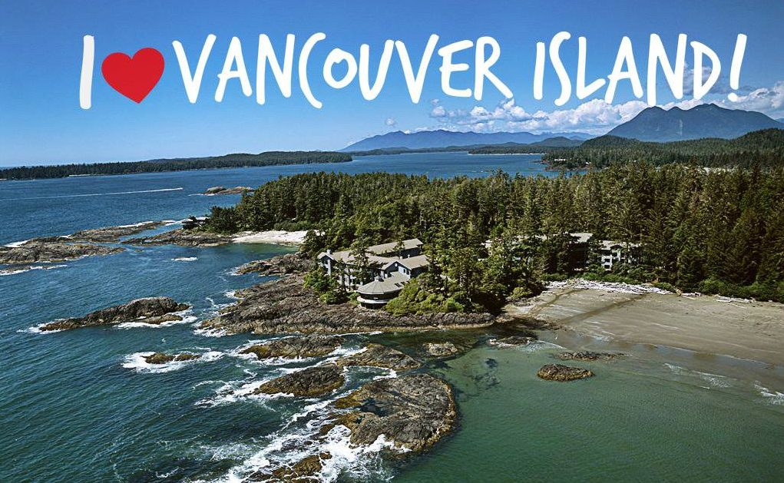
Feedback
What went well?
What needs improvement, clarification, or any other suggestions?

Slide 13
Have a nice day!

