Slide 1
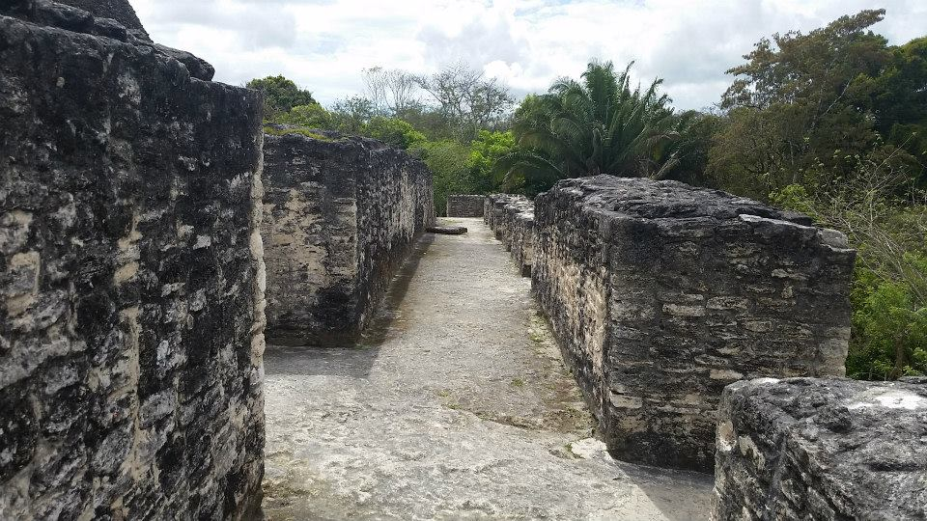
-------------
Tour Guiding
STHC/ TESL 3050

Slide 2
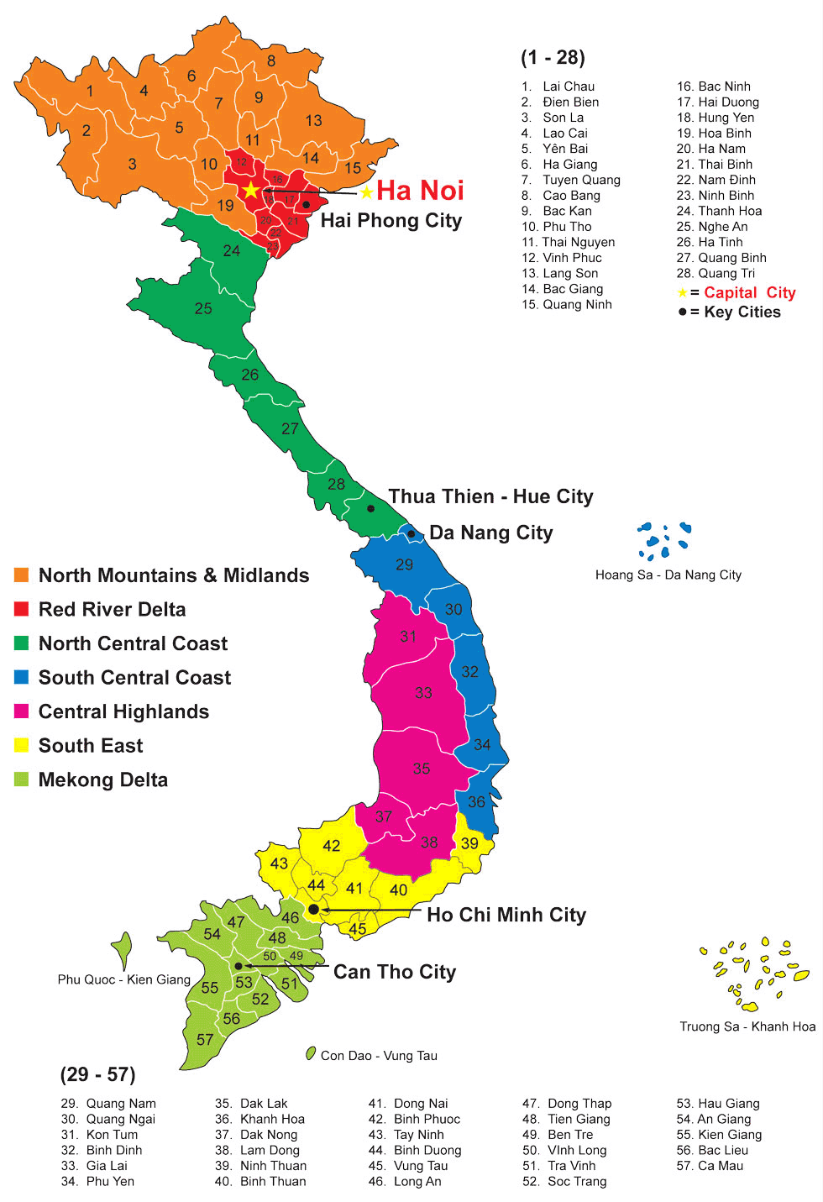

Slide 6
Vocabulary
Souvenir
Monument/Landmark
Travel Agency
Destination
Itinerary
Bank
Hospital
To Drive
To Ride
To Plan
To See a show
To Hike
To Take a video

Slide 7
Tour Groups
Adventure Tourists
Enjoy nature
Enjoy Thrills/Excitement
Unique
Low Budget
Historical Tour Group
Educational
Comfortability
Culture/Art
High Budget
Families
Has Children
Likes animals
7:00pm Curfew
Low Budget
Businessmen
Need for decompression/downtime
Would like alcohol
Would like to see a show
High Budget

Slide 8
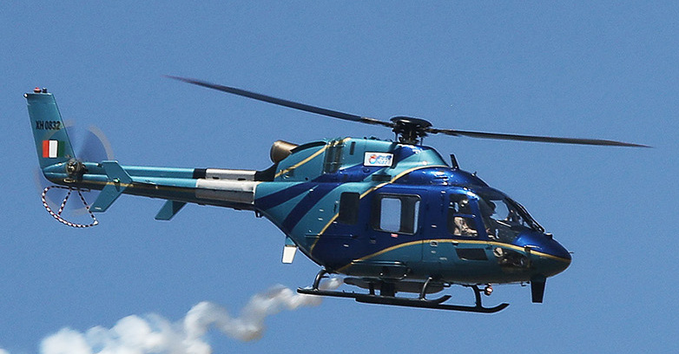
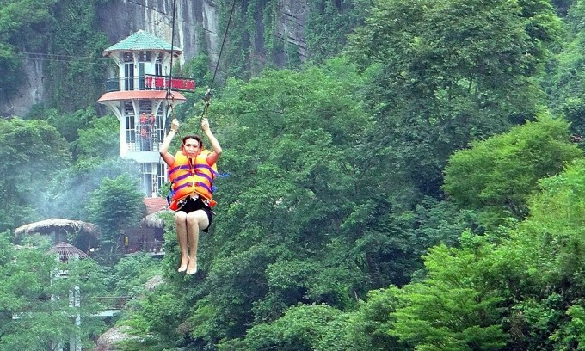
Plan an itinerary
Starting from the Saigontourist Hospitality College, prepare a trip to one site in Vietnam (Individually, or in pairs)
Select a destination
Arrange transportation (Taxi, Boat, Helicopter, Etc)
Plan two fun activities related to your chosen site
Walking tour, cycling, dinner, etc
Originality is encouraged
Use of Internet is permitted

Slide 9
Video Blogging
https://www.youtube.com/watch?v=GN7QR-rTOkw&t=28s

Slide 10
Prepare your Vlog by answering these questions.
What district is your landmark in?
What is the best way to travel?
Tell us an interesting fact about your location.
How much does it cost?
Which kind of Tourist would likely enjoy this site?

Slide 11
Feedback
What went well?
What needs improvement, clarification, or any other suggestions?
Any other questions?

Slide 12
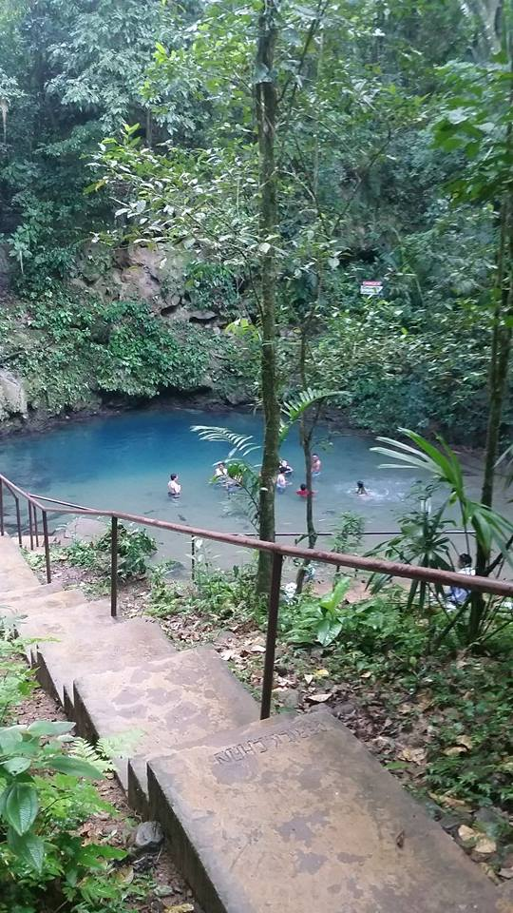
Have a nice day!

