Slide 1
Transportation
Esal 0450-01/TEsL 3050

Slide 2
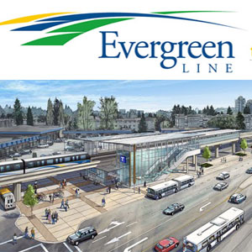
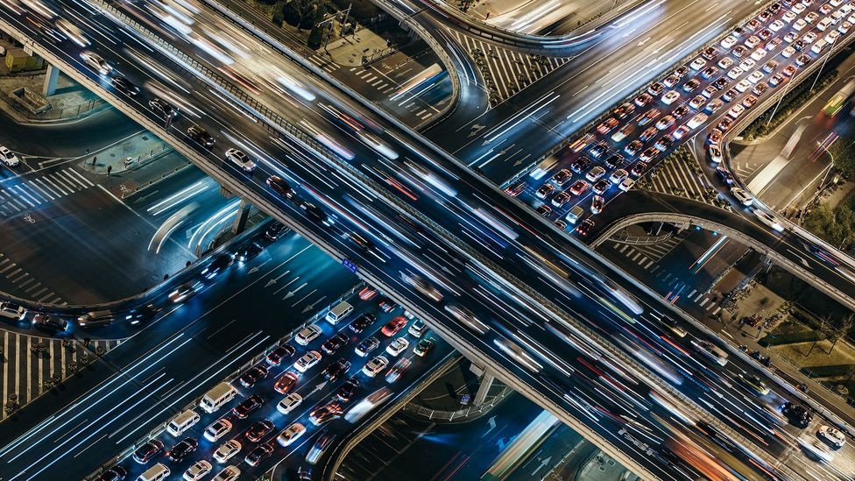
Do you prefer to travel by car or by public transportation?

Slide 3
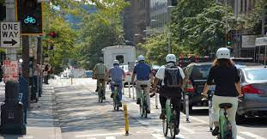
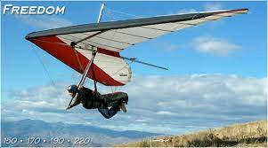
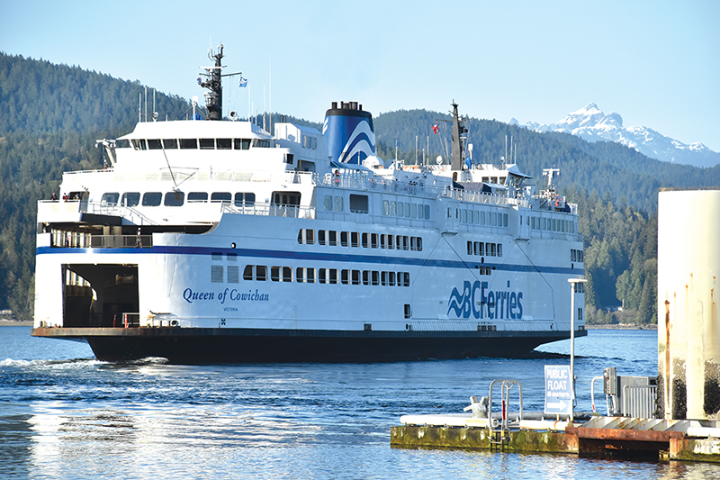
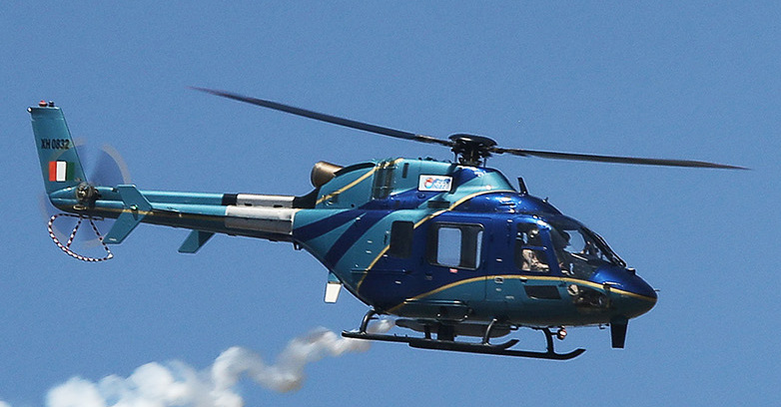
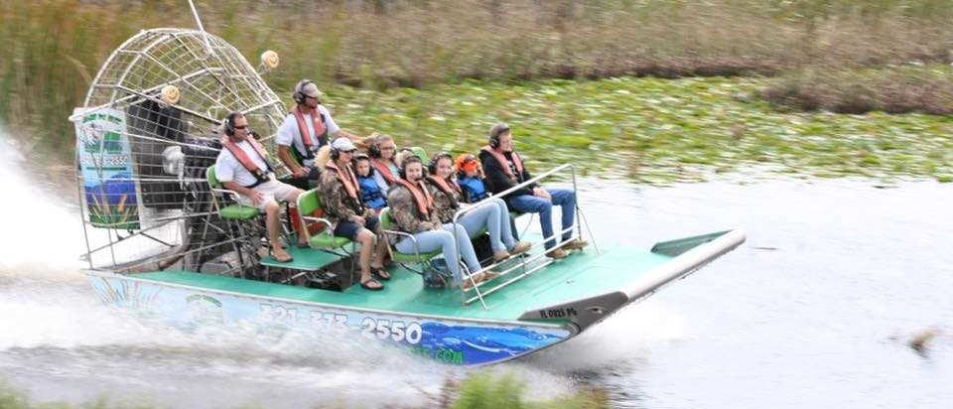
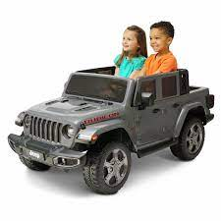
What forms of transportation are in your home country?

Slide 4
Vocabulary
Commute
Highway
Traffic
Intersection
Ferry
Collision
Helicopter

Slide 5
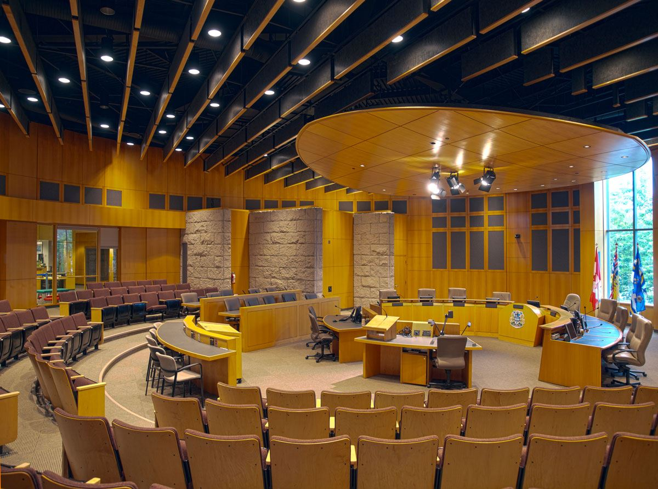
Urban Planning and Development
You have been elected to the city council of Kamloops
In groups of 3-4, list 5 ideas, strategies, tips or reforms to improve public transportation
Use of the internet is permitted
Present your groups ideas to the class

Slide 6
Feedback
What went well?
What needs improvement, clarification, or any other suggestions?

Slide 7
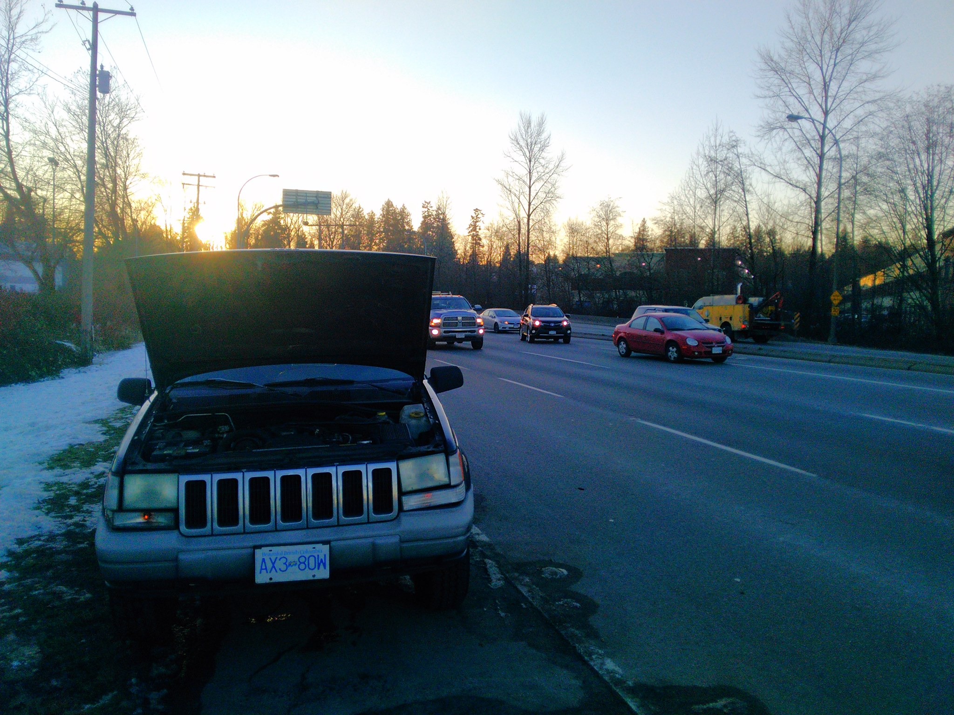
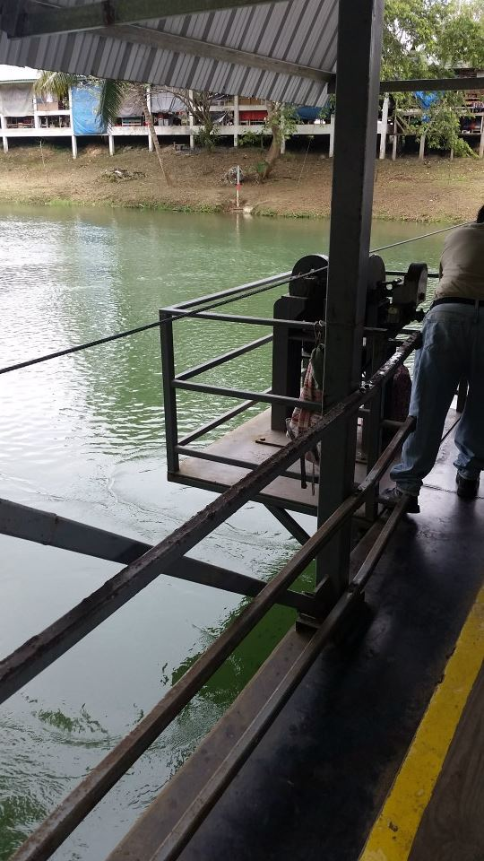
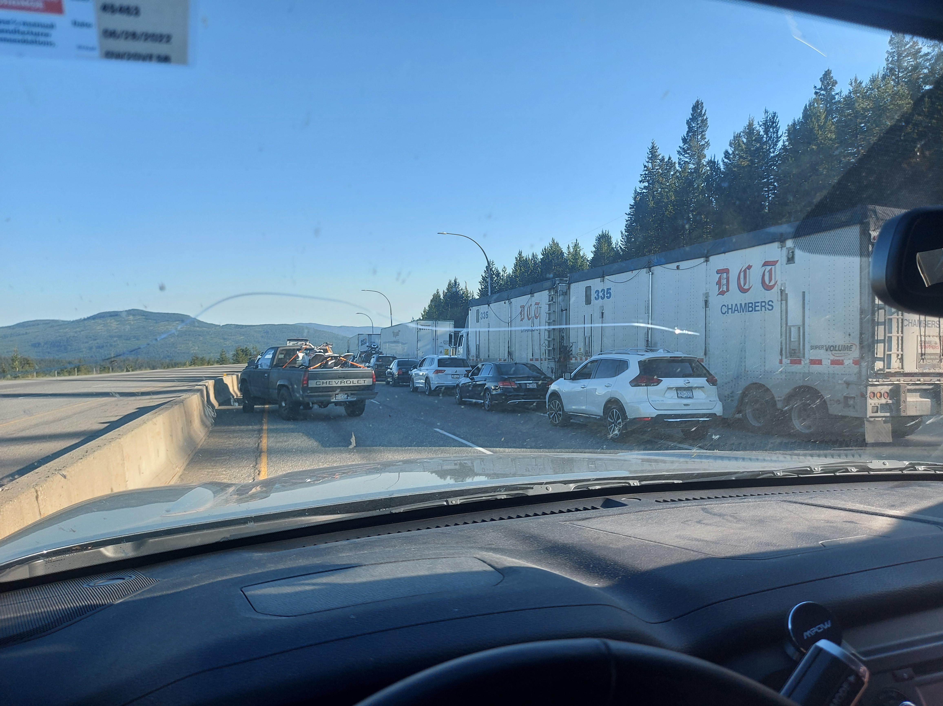
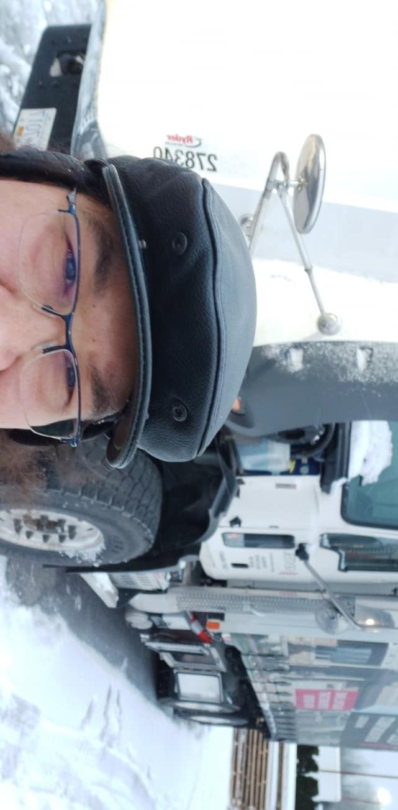
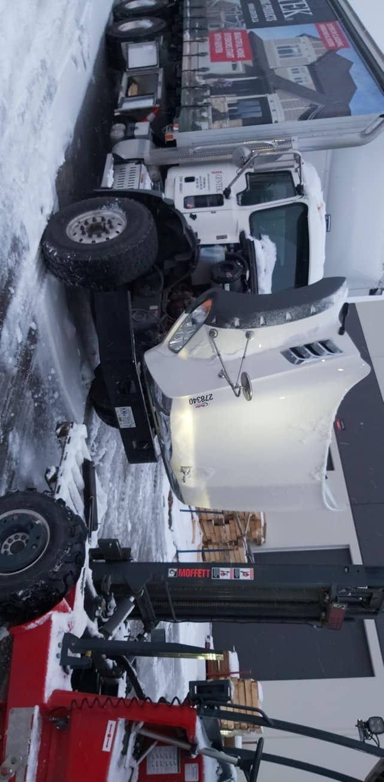
Have a nice day!

