Slide 1
Planning a vacation or leisurely activity
Esal 0450-01/TEsL 3050

Slide 2
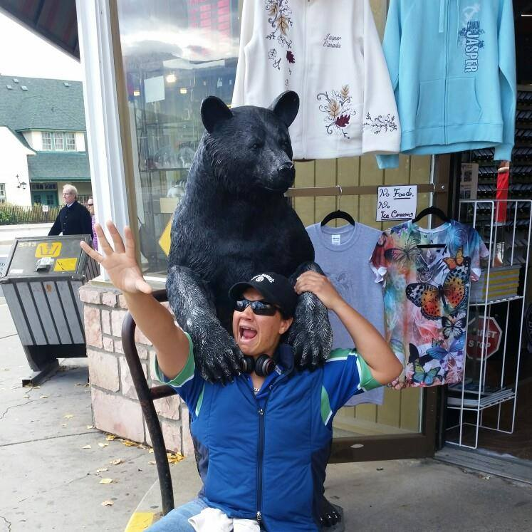
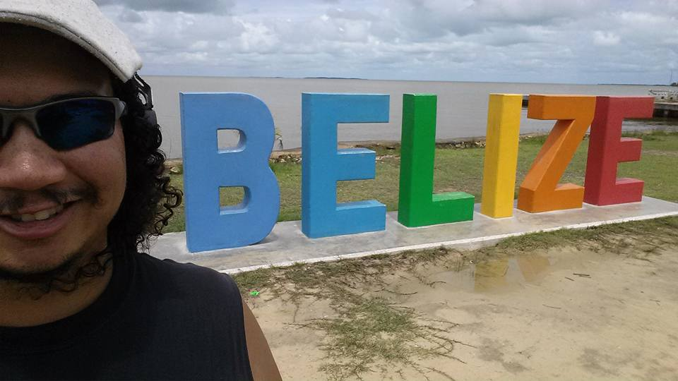
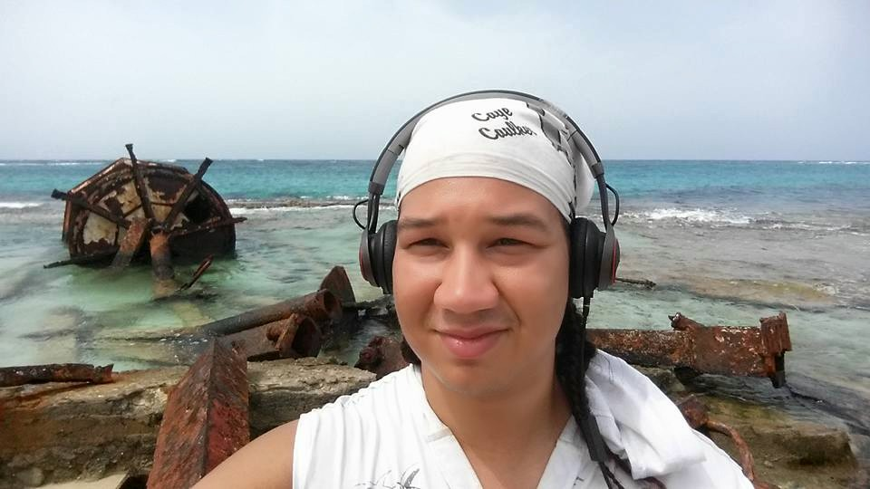
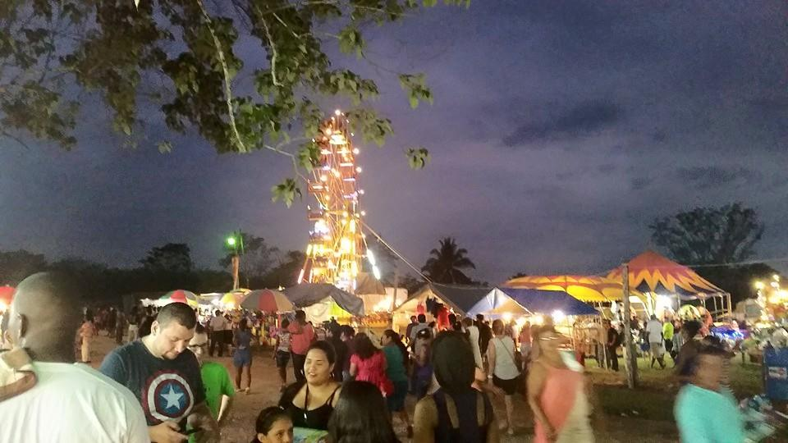
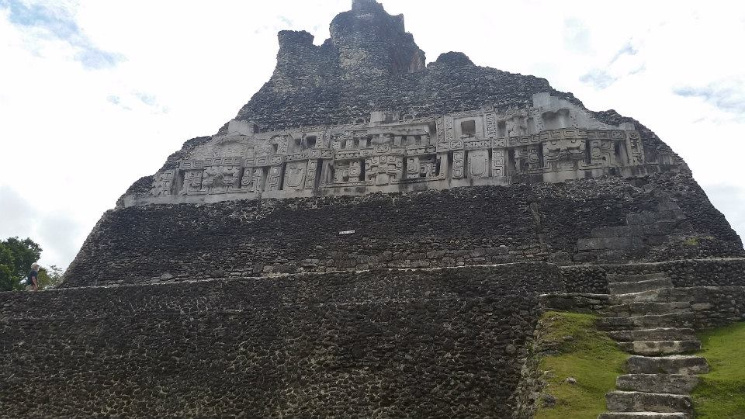
Where have you visited?

Slide 3
Vocabulary
Souvenir
Monument/Landmark
Tour/Tourism
Beach
Travel Agency
Recreation
Amusement Park
Hotel/Motel
Resort
Destination
Itinerary
Cruise
Festival
Cuisine

Slide 4
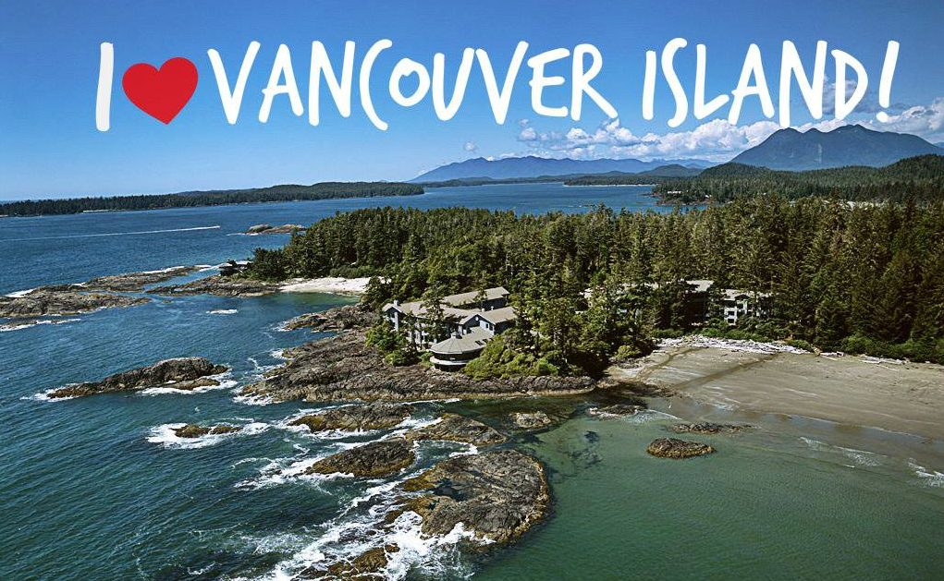
Feedback
What went well?
What needs improvement, clarification, or any other suggestions?

Slide 5
Have a nice day!

