Slide 1
Hobbies, Jobs and Careers
Esal 0450-01/TEsL 3050

Slide 2

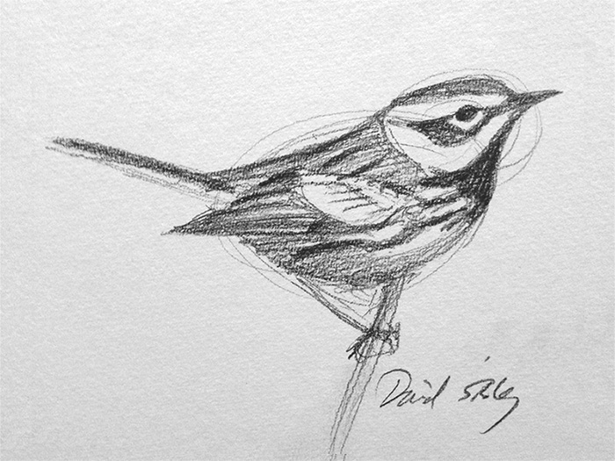
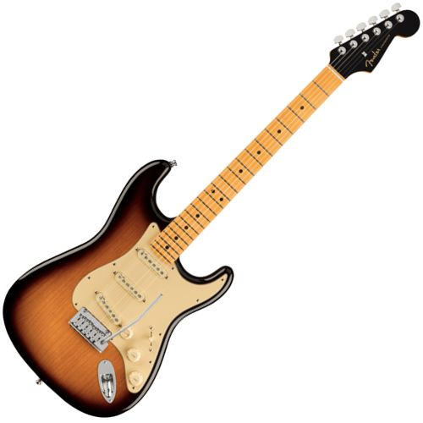

Are there any hobbies or interests you would be willing to share with class?

Slide 3
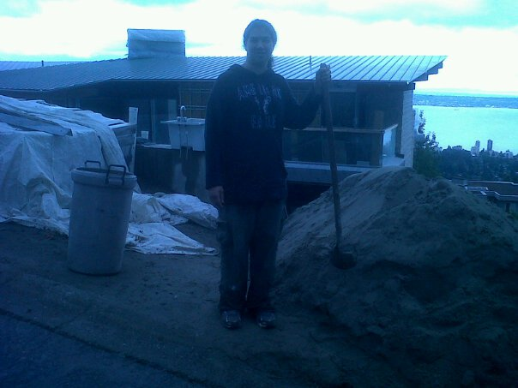
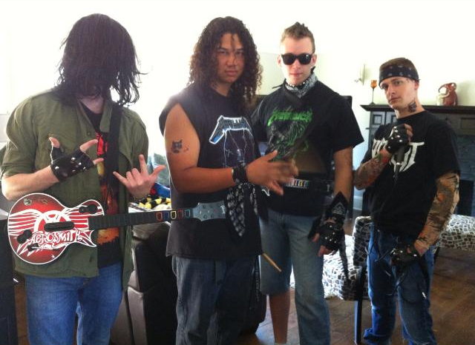
What did you want to be when you grew up?
How has that goal changed as you got older?

Slide 4
Vocabulary
Prospective
Qualifications
Occupation
Applicant
Reminisce
Bygone
Obsolete

Slide 5
Share some tips and advice with your fellow classmates
Presentation/Personality
Skills they should enhance or acquire
Personal experience
Expectations
Other suggestions
Groups, prepare to share 3 pieces of advice with the class.

Slide 6
Feedback
What went well?
What needs improvement, clarification, or any other suggestions?

Slide 7
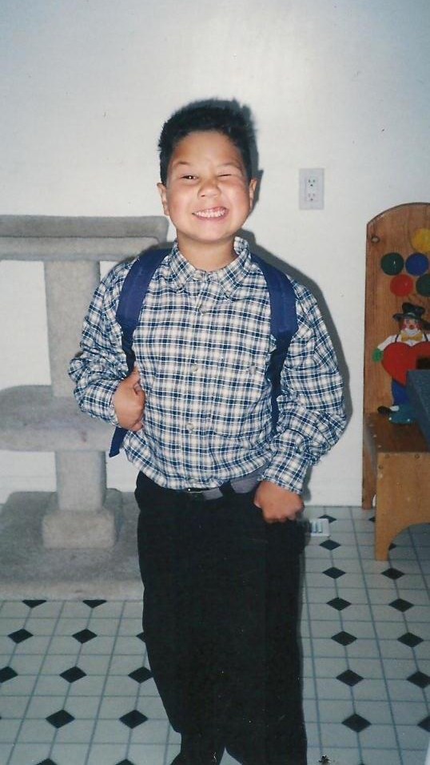
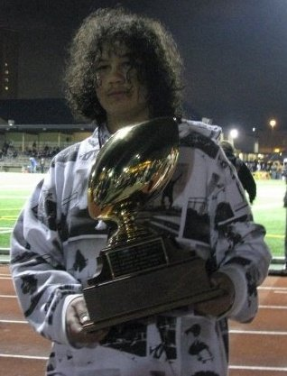
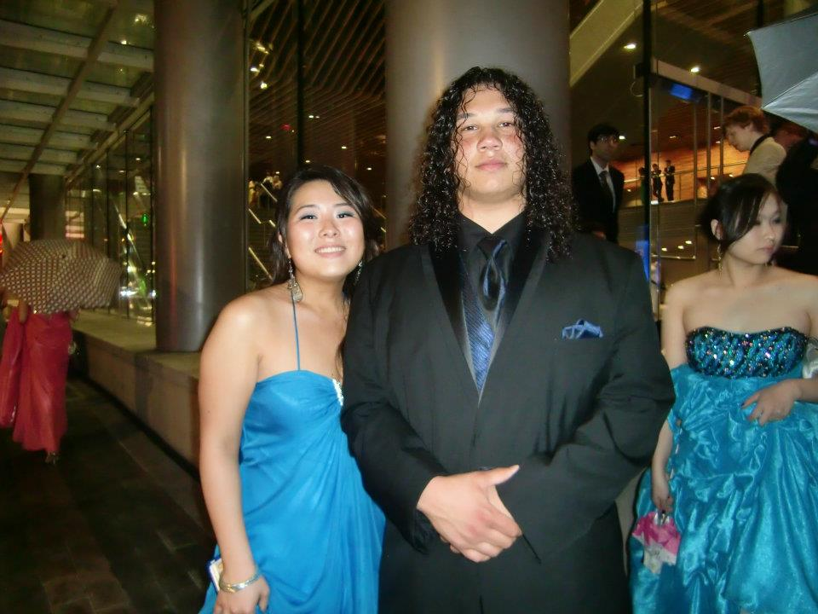
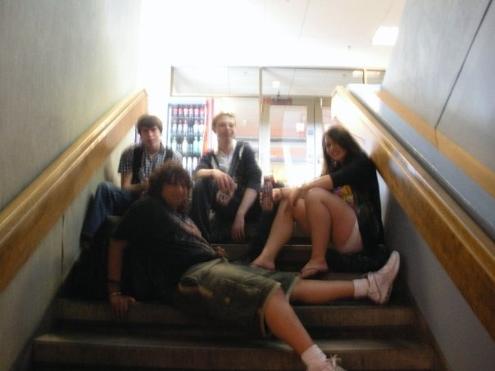
It has been such a pleasure to teach you this semester
Thank you all so much

