Slide 1
Ethics of Animal use
Esal 0450-01/TEsL 3050

Slide 2
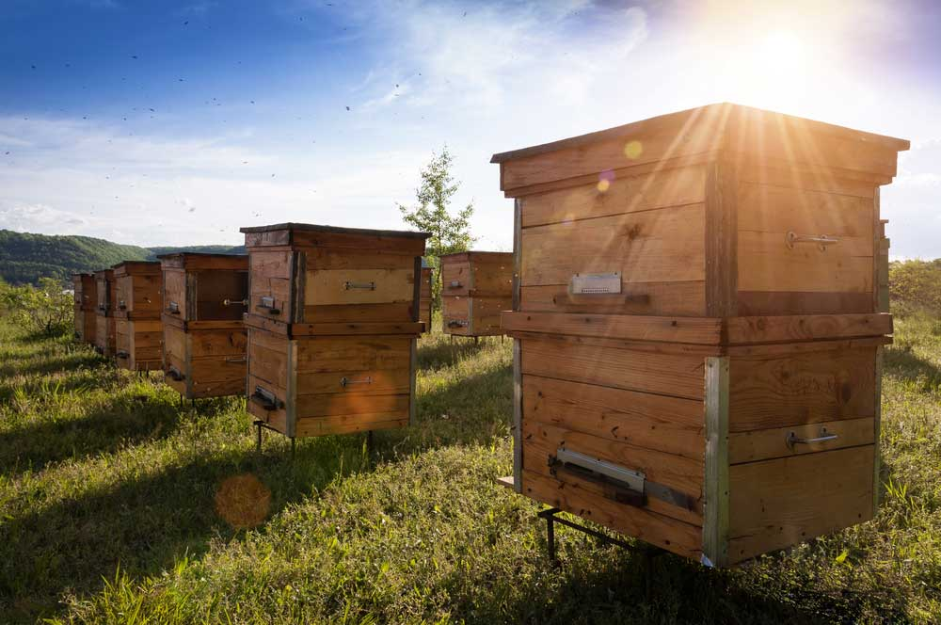
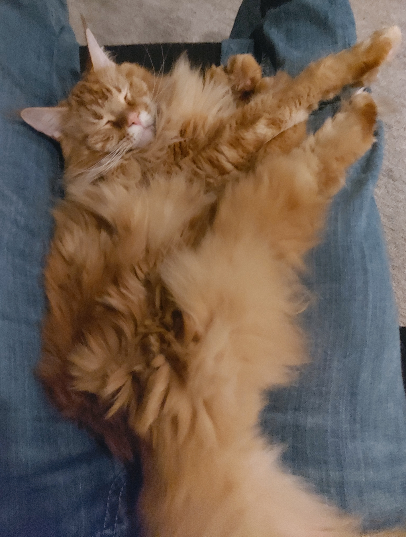
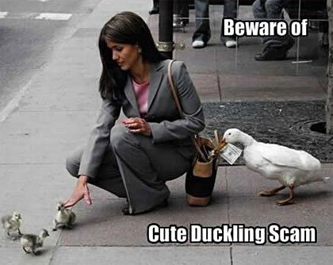
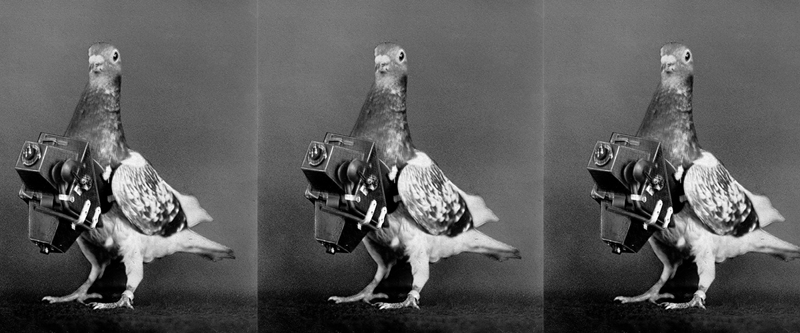
What do we use animals for?

Slide 3
Food Guides

Slide 4
Vocabulary
Crunchy
Savoury
Chewy
Vitamins & Minerals
Poultry
Herbs & Spices
Fried
Boiled
Steamed
Sauteed
Roasted
Kitchen
Flavours
Chef

Slide 5
Feedback
What went well?
What needs improvement, clarification, or any other suggestions?

Slide 6

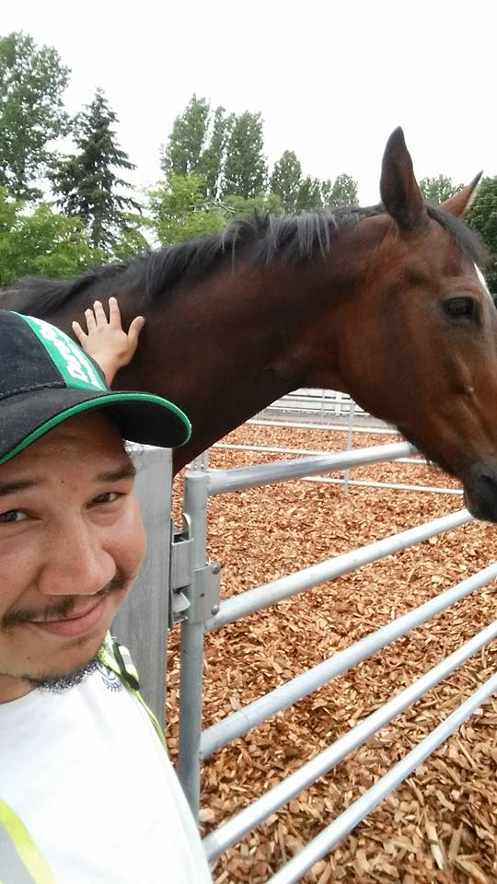

Have a nice day!

