Slide 1
Trends that empower nature
Esal 0450-01/TEsL 3050

Slide 2
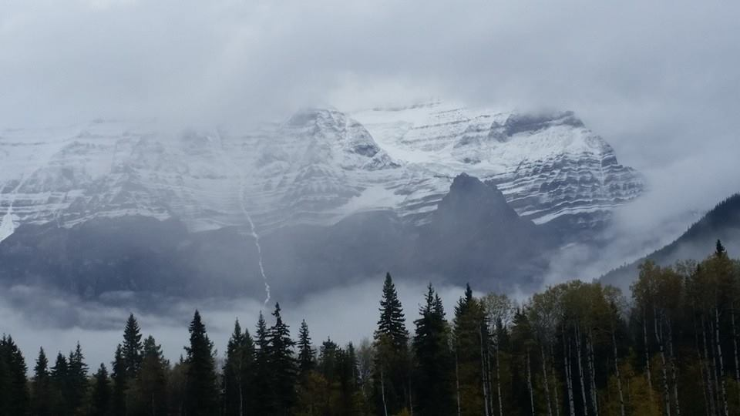
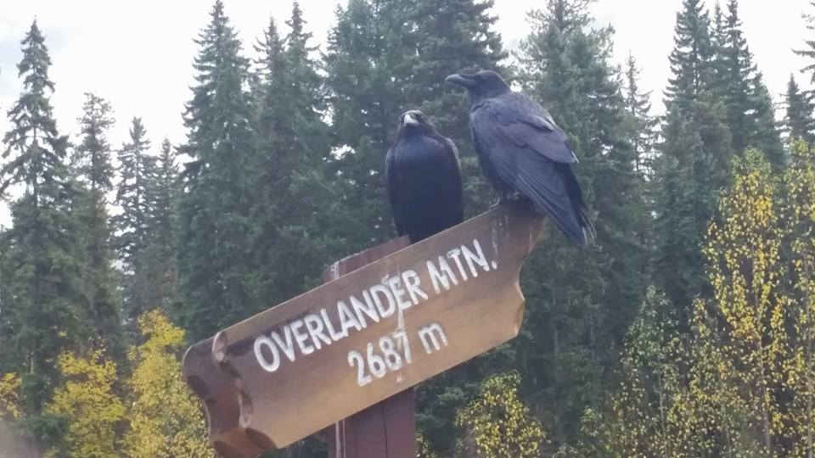

Slide 3
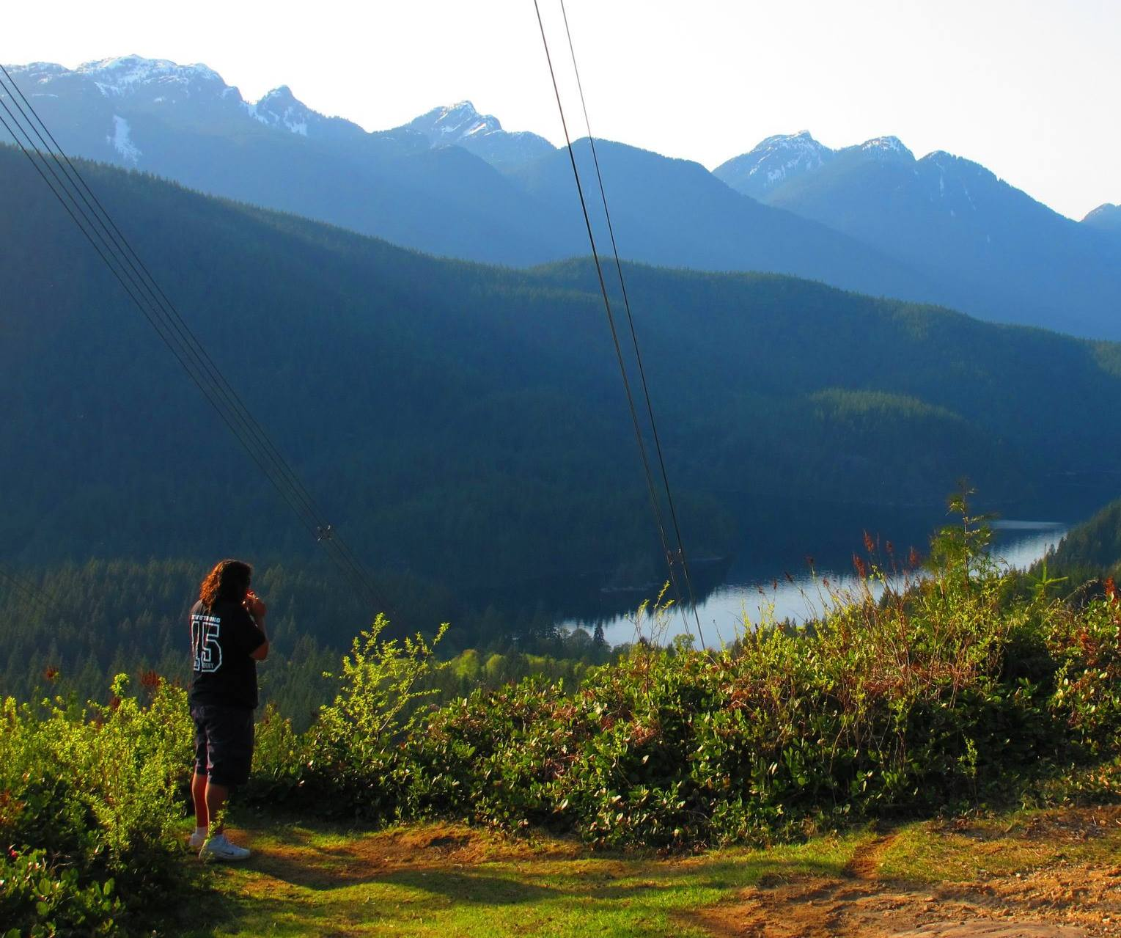
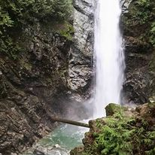

Slide 4
Describe a natural area from your home. What is something you can do in nature?
Adjectives
Refreshing
Relaxing
Beautiful
Nouns
Forest
Grasslands
Mountains
Plants
Animals
Picnic
Verbs
To hike/To trek
To observe
To swim
To ski

Slide 5
What are some trends that individuals or communities can do to lessen human impacts on the Environments?
Use your laptop or phone if you can not think of any ideas of your own
Produce two ideas for each
The community
The individual
If in a group of three, then two ideas for how a business could help the environment

Slide 6
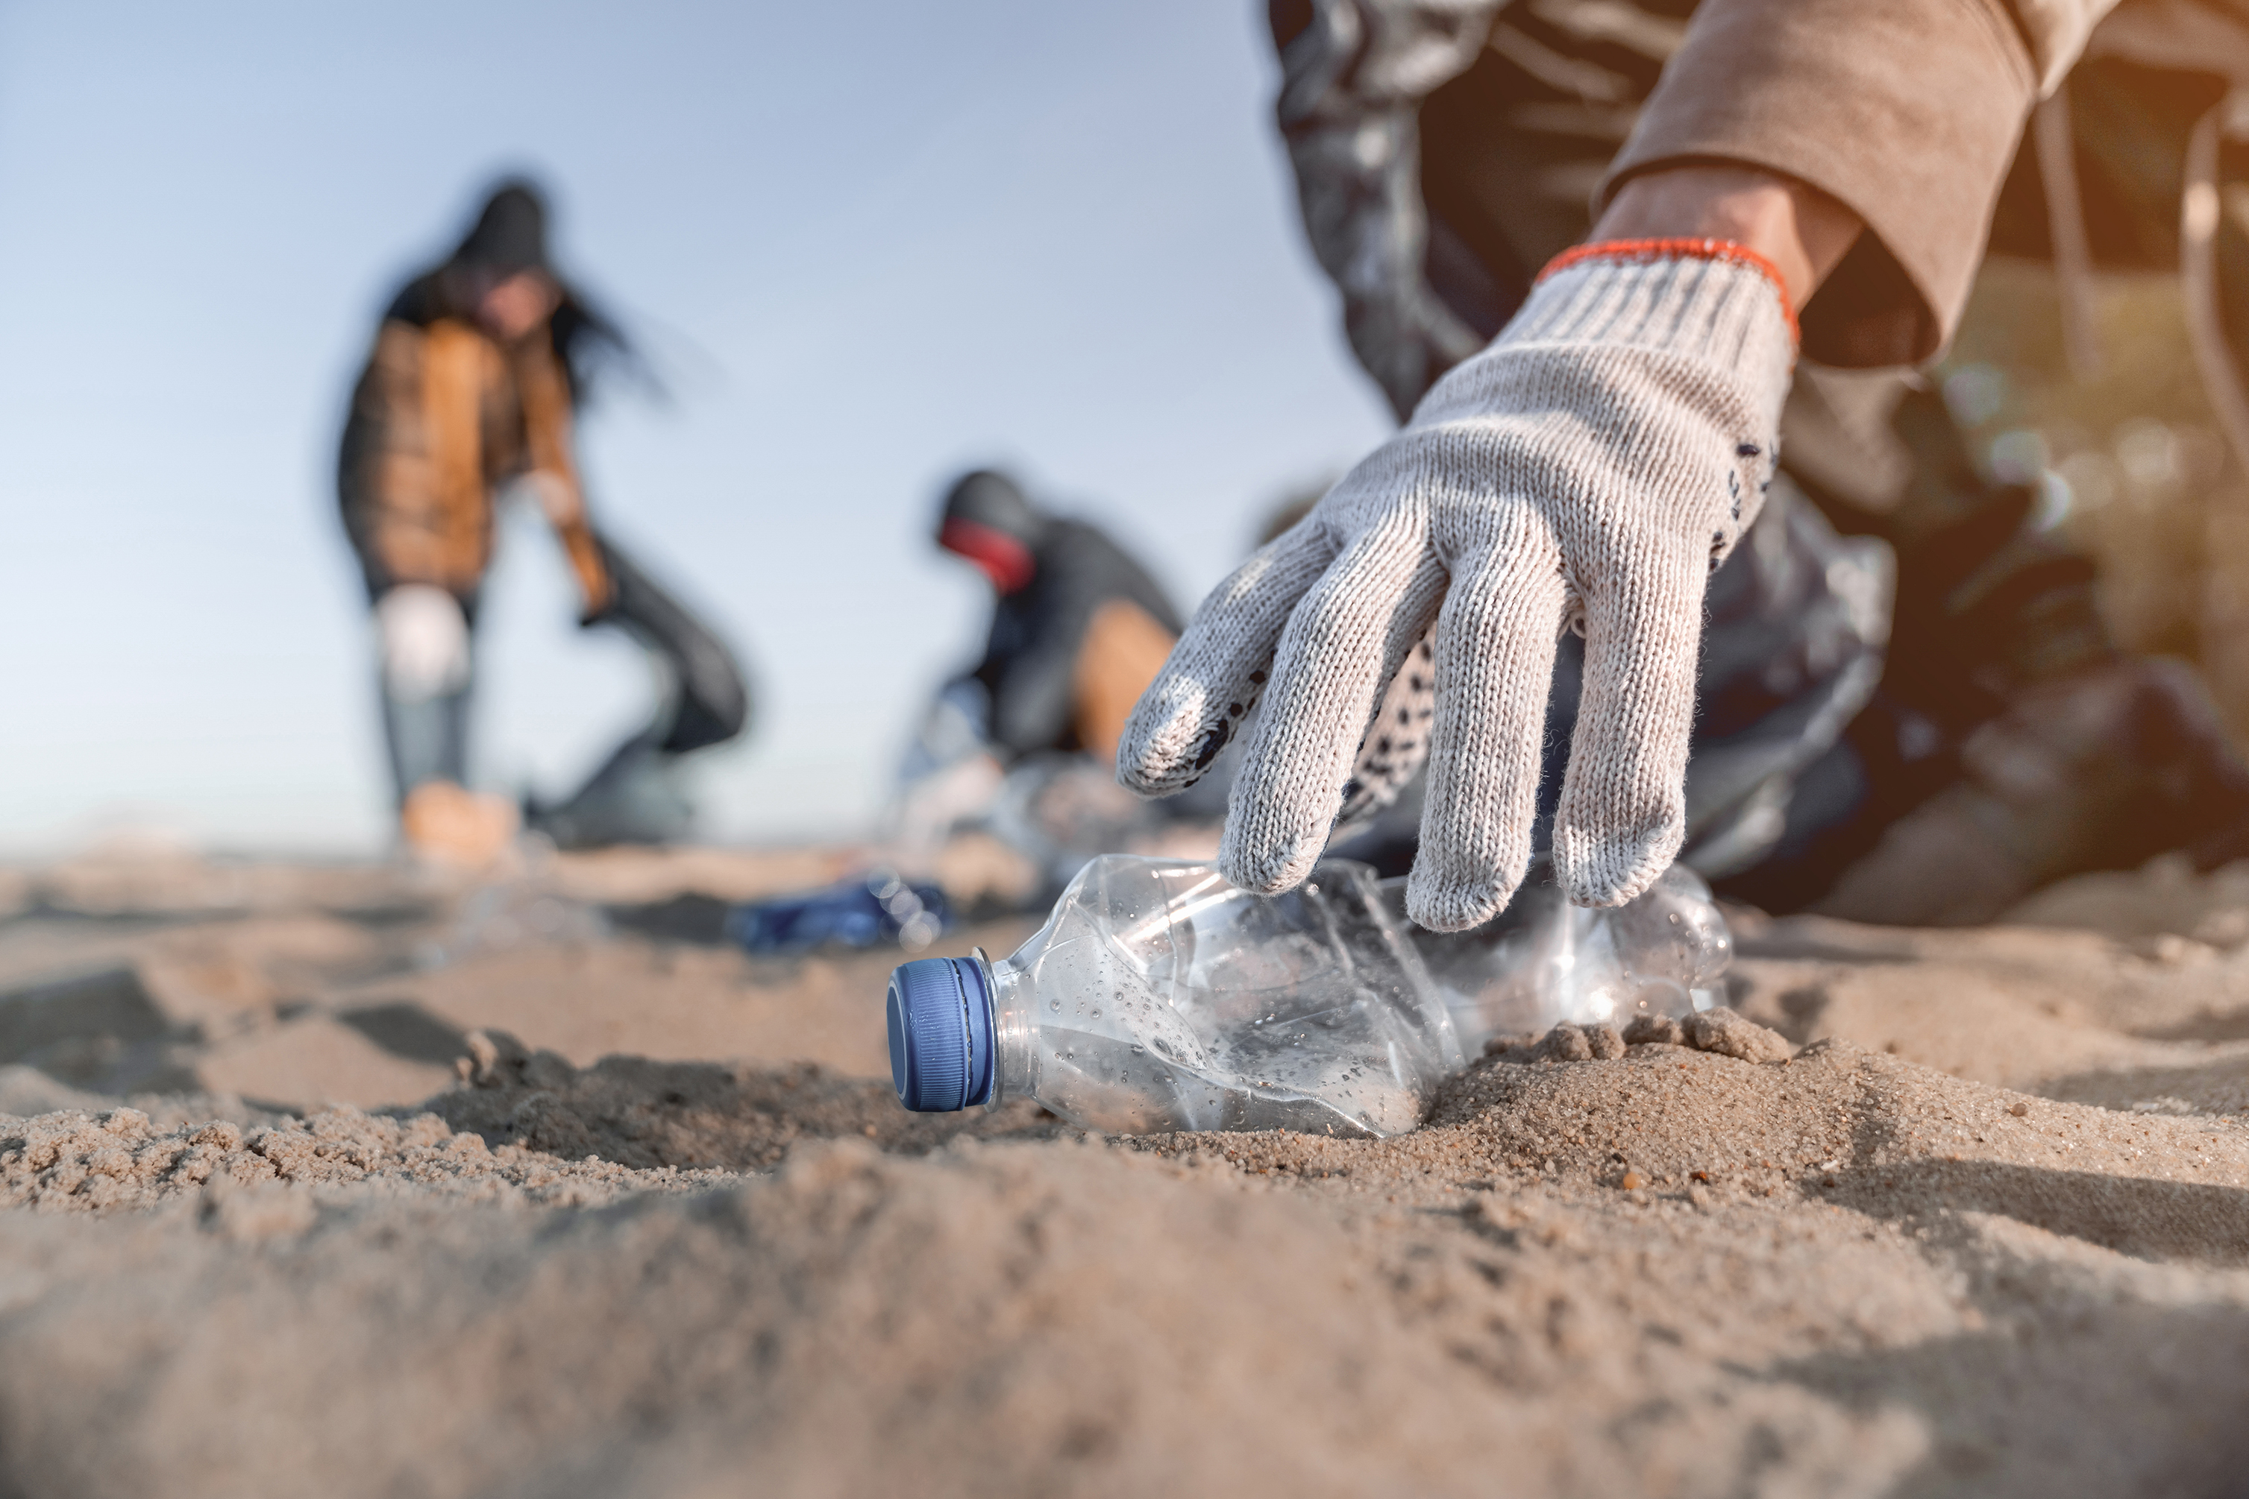
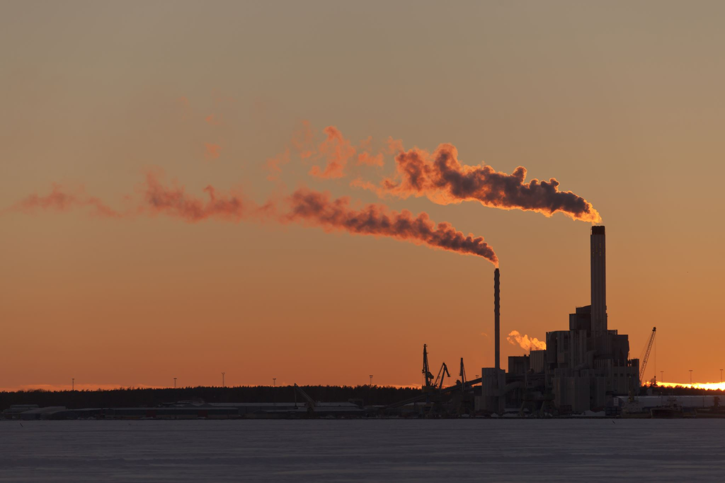
Why is it important to develop trends and routines to help prevent damage to the Environment?

Slide 7
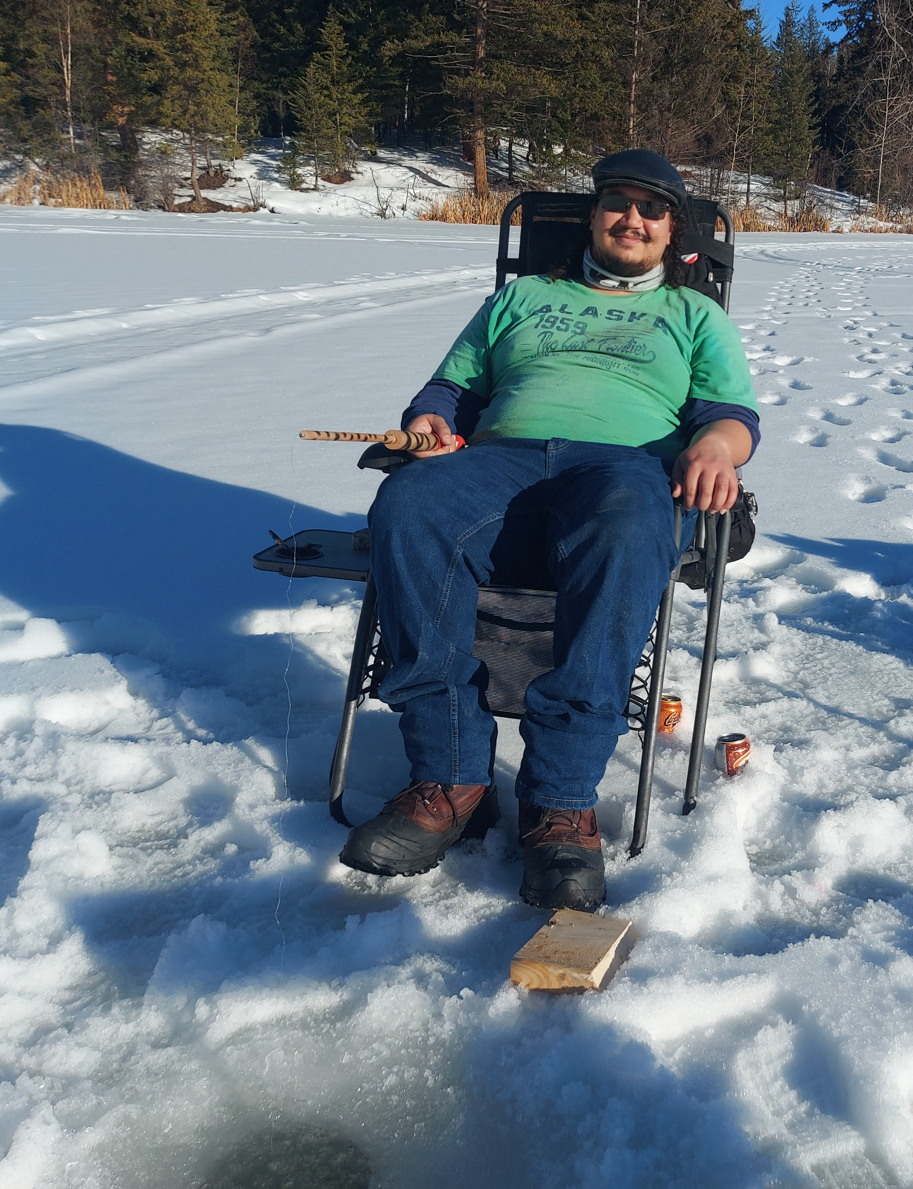
Have a nice day!

