Slide 1
Discussing recycling and other green trends
Esal 0450-01/TEsL 3050

Slide 2

Do you consider yourself environmentally savvy?

Slide 3
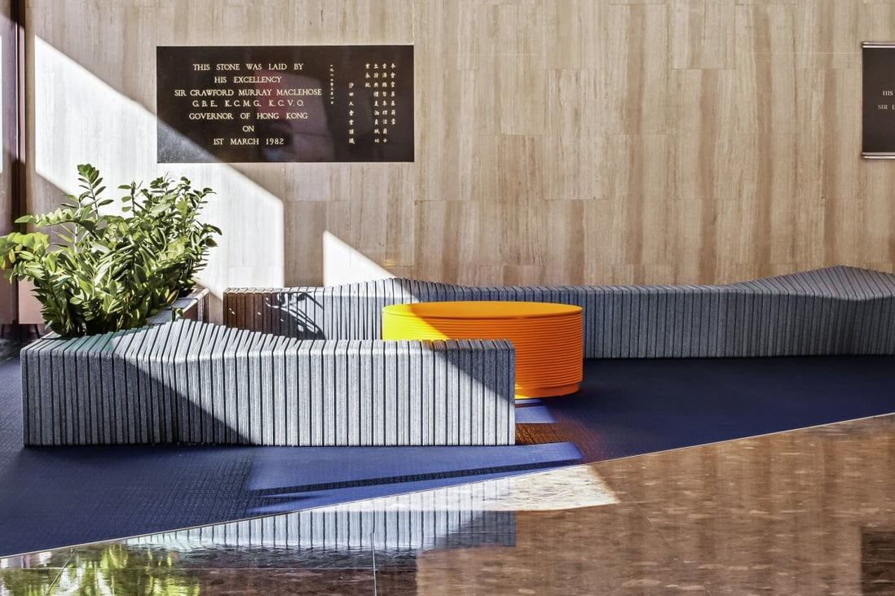
“Old milk containers, juice jugs and toy cups are not the type of products usually associated with high-concept furniture, but two designers in Hong Kong have taken these and other items and upcycled them into stylish pieces of public furniture.” (Cobaj & Cobaj, 2021)

Slide 4
What else can be recycled?

Slide 5
Organic Waste
August 21,2023, the City of Kamloops will begin Curbside pickup of organic waste
Weekly pickups
Organic: relating to or derived from living matter

Slide 6
Food scraps
Lightbulbs
Cardboard
Egg shells
Feathers
Bleach
Juice boxes
Plastic shopping bags
Hair
Carrot peel
Coffee grinds
Tea bags
Paper towel
Paper Bags
Aluminum Can
Apple core
Grass clippings
Oil/Grease
Pizza box
Broken Laptop
Wires/Cables
Shampoo bottle

Slide 7
On your worksheet, list 2 more items that can be composted
Use of internet is allowed

Slide 8
Feedback
What went well?
What needs improvement, clarification, or any other suggestions?

Slide 9
Have a nice day!

